Slide 1
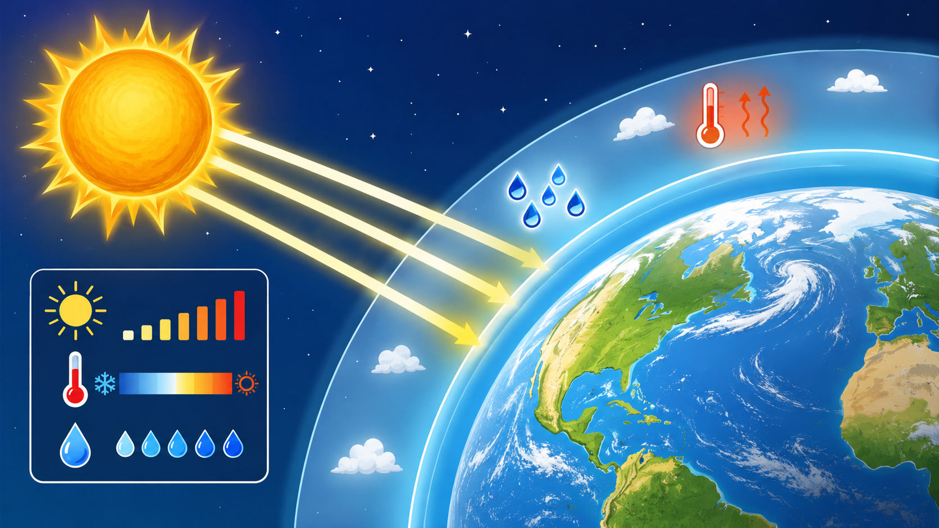
Our Planet Earth
in our Solar System
Measure natural light, air temperature and relative humidity. Use evidence to explain what happens when sunlight reaches our atmosphere.
No WiFi needed
OLED + SD card
Pairs or teams
MaxIQ Space | Springbot Space STEM | 1

Slide 2
Today’s learning mission
Learners act like junior Earth observation scientists.
Observe
Measure
Explain
Read Springbot measurements from different places.
Record light intensity, air temperature and relative humidity.
Use data to present results, findings and conclusions.
Mission question: How do sunlight, shade and indoor conditions change the air around us?
MaxIQ Space | Springbot Space STEM | 2

Slide 3
Curriculum links
A practical extra-curricular session that supports CAPS concepts.
Grades 4-6 Natural Sciences & Technology: Planet Earth and Beyond - Earth in space, Sun, Earth and Sun, Solar System.
Grade 6 Natural Sciences & Technology: Earth rotation, day and night, revolution around the Sun.
Grade 7 Natural Sciences: Relationship of the Sun to Earth - solar energy, seasons and life on Earth.
Grades 4-7 Mathematics: measurement and data handling - collect, organise, graph, analyse and report data.
Facilitator note: keep the science accurate and age-appropriate. Learners do not need detailed atmospheric physics; they need to connect sunlight, measurements and evidence.
MaxIQ Space | Springbot Space STEM | 3

Slide 4
Earth receives light and heat from the Sun
This makes Earth different from most places we know in space.
The Sun is our closest star.
Sunlight travels through space and reaches Earth.
Earth’s atmosphere is a thin layer of air around the planet.
Different places can have different light, temperature and humidity readings.
Big idea: we can investigate our planet by measuring the environment around us.
MaxIQ Space | Springbot Space STEM | 4

Slide 5
What will Springbot measure?
Three readings help us compare local conditions.
☀
Light intensity
🌡
Air temperature
💧
Relative humidity
How bright the light is. This usually changes quickly between sunlight and shade.
How hot or cold the air is. Warm surfaces and sunlight can warm nearby air.
How much water vapour is in the air compared with the most the air can hold.
Learners read the values from the OLED screen. If SD logging is active, the Springbot also saves the readings as a CSV file.
Light + Temperature + Humidity = local environmental evidence
MaxIQ Space | Springbot Space STEM | 5

Slide 6
Investigation question and prediction
Start with what you think will happen.
How do light intensity, air temperature and relative humidity differ between sunlight, shade and indoors or deep shade?
Useful predictions
Remember
The sunny area will have the highest light intensity.
The sunny area may be warmer than shade.
Humidity may be different when temperature changes.
A prediction is not a guess with no reason.
Use “because” to explain your thinking.
Your conclusion may support or reject your prediction.
MaxIQ Space | Springbot Space STEM | 6

Slide 7
Experiment design
Compare three safe places. Keep the method consistent.
Sunny area
Shaded area
Indoor or deep shade
highest light expected
lower light, cooler surfaces
lowest natural light expected
Fair testing tips
Use the same Springbot for the same group.
Hold it at the same height each time.
Wait about one minute before recording.
Avoid touching or covering the sensors.
Write notes about wind, clouds, surfaces and shade.
MaxIQ Space | Springbot Space STEM | 7

Slide 8
Data collection without WiFi
Use the OLED screen and, where available, the SD card CSV file.
At each location, wait for the readings to settle.
Read light, temperature and humidity from the OLED screen.
Write readings immediately on the worksheet.
If SD logging is active, check that the CSV file is saved after the activity.
Use the CSV later to draw graphs on a computer.
Tip: one learner reads the OLED; the other learner records the data.
MaxIQ Space | Springbot Space STEM | 8

Slide 9
Analyse your results
Turn readings into findings.
Find the highest and lowest light readings.
Find the highest and lowest air temperatures.
Find the highest and lowest humidity readings.
Calculate the difference between highest and lowest values.
Draw a bar graph or line graph to show your results.
Example sentence frames
“The highest light reading was in...”
“The air temperature was higher in...”
“Our data suggests that...”
MaxIQ Space | Springbot Space STEM | 9

Slide 10
Present results, findings and conclusions
A good science presentation uses evidence.
Question
Prediction
Method
Results
Finding
Conclusion
Improvement
Each pair speaks for about 2 minutes.
Use evidence: “We know this because our Springbot readings showed...”
Say what was measured.
Show or describe the graph.
Explain the pattern in the data.
Be honest about anything that made the readings less fair.
MaxIQ Space | Springbot Space STEM | 10

Slide 11
How presentations are assessed
Simple 20-mark rubric.
Science
Correct explanation of Sun, light, temperature and humidity.
4 marks
Method
Springbot used safely and fairly.
4 marks
Data
Measurements recorded clearly.
4 marks
Conclusion
Conclusion supported by evidence.
4 marks
Teamwork
Clear communication and shared roles.
4 marks
Strong presentations make a clear link between data and conclusion.
MaxIQ Space | Springbot Space STEM | 11

Slide 12
Exit mission
One planet. One Sun. Many local conditions to measure.
Before you leave, answer:
What did your Springbot show you about sunlight?
How did temperature and humidity change?
What would you measure next?
Thank you
MaxIQ Space | Springbot Space STEM | 12

