Slide 1
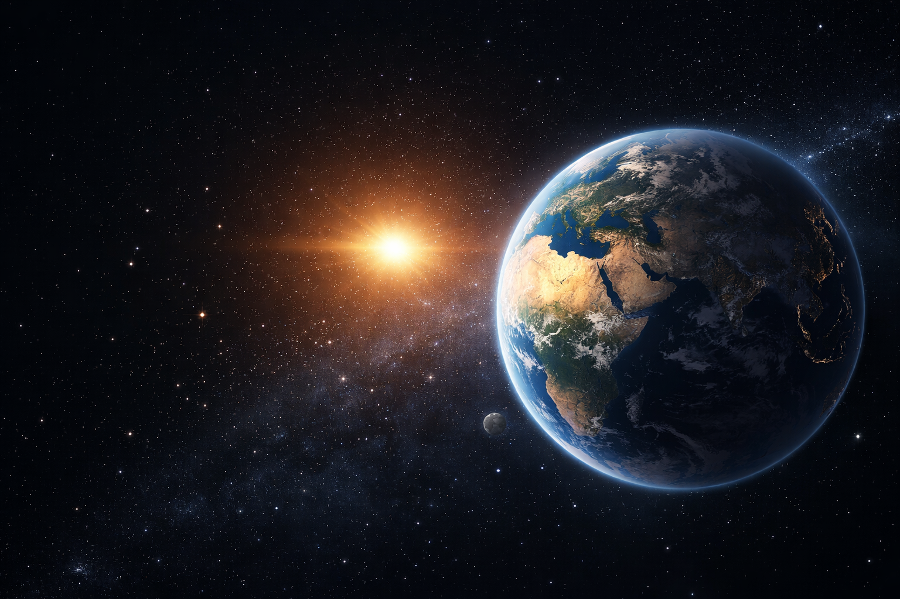
Our Planet Earth in our solar system
A two-hour extra-curricular investigation measuring natural light intensity, air temperature and humidity data
For Grade 8-11 learners
No Wi-Fi required
Output - OLED or micro SD CSV
Goal: measure sunlight’s effects locally
MaxIQ Space | Space STEM kit support materials
Notes:
[Sources]
Generated image asset: OpenAI image generation (Earth scene), created for this deck.
CAPS Natural Sciences Grades 7-9: Earth is the third planet from the Sun and conditions for life on Earth; Solar System content (uploaded file: CAPS SP NATURAL SCIENCES GR 7-9 WEB.pdf, pp. 53-54).
CAPS Natural Sciences Grades 7-9: Relationship of the Sun to the Earth and solar energy sustaining life (uploaded file: CAPS SP NATURAL SCIENCES GR 7-9 WEB.pdf, p. 32).
[/Sources]

Slide 2
Where this connects to CAPS
The topic is cross-curricular across Natural Sciences, Physical Sciences and Life Sciences
Phase / grade | Relevant CAPS link | How this lesson uses it
Natural Sciences Gr 7 | Sun-Earth relationship, solar energy and seasons | Introduces sunlight as the energy source and connects Earth’s position to life-supporting conditions.
Natural Sciences Gr 8 | Solar System and visible light | Explains Earth in the solar system and uses light intensity as a measurable local phenomenon.
Natural Sciences Gr 9 | Atmosphere and greenhouse effect | Supports discussion of air, ozone, temperature and why the atmosphere matters.
Physical Sciences Gr 10 | Waves, sound and light; electromagnetic radiation | Provides background for visible light and the broader idea of sunlight as electromagnetic radiation.
Life Sciences Gr 10-12 | Practical investigation skills | Learners measure, record, graph, interpret and communicate findings.
Note: relative humidity is included here as a practical extension using the kit. It strengthens inquiry and data interpretation even when it is not named as a standalone CAPS topic in these extracts.
MaxIQ Space | Space STEM kit support materials
Notes:
[Sources]
CAPS Natural Sciences Grades 7-9: Relationship of the Sun to the Earth and solar energy sustaining life (uploaded file: CAPS SP NATURAL SCIENCES GR 7-9 WEB.pdf, p. 32).
CAPS Natural Sciences Grades 7-9: The Solar System, Earth’s position in the Solar System, conditions for life, and visible light content (uploaded file: CAPS SP NATURAL SCIENCES GR 7-9 WEB.pdf, pp. 51-54).
CAPS Natural Sciences Grades 7-9: Atmosphere, ozone, and greenhouse effect (uploaded file: CAPS SP NATURAL SCIENCES GR 7-9 WEB.pdf, pp. 81-82).
CAPS Physical Sciences Grades 10-12: Grade 10 waves, sound and light and electromagnetic radiation (uploaded file: CAPS FET PHYSICAL SCIENCE WEB.pdf, pp. 30-31).
CAPS Life Sciences Grades 10-12: practical investigation skills including measuring, recording data, graphing and interpreting (uploaded file: CAPS FET _ LIFE SCIENCES _ GR 10-12 Web_2636.pdf, pp. 16-17, p. 23).
[/Sources]

Slide 3
What learners investigate
A simple sequence that non-specialist facilitators can run confidently
1
1. Big idea
2
2. Field experiment
3
3. Share findings
Earth can support life because it has sunlight, an atmosphere and suitable conditions.
Learners connect lessons about the Sun and atmospheric conditions through practical experimentation.
Pairs of learners compare three locations such as full sun, partial shade and deep shade.
They record light intensity, air temperature and relative humidity.
Groups calculate averages, draw one graph and present a short claim-evidence-explanation-conclusion summary.
Suggested timing: 25 min background | 50 min data collection | 25 min analysis | 20 min presentations
MaxIQ Space | Space STEM kit support materials
Notes:
[Sources]
Sequence and practical focus are designed by the assistant for the user brief.
CAPS Natural Sciences Grades 7-9: process skills include observing, measuring, recording information, interpreting and communicating (uploaded file: CAPS SP NATURAL SCIENCES GR 7-9 WEB.pdf, pp. 10-11).
CAPS Life Sciences Grades 10-12: investigating phenomena includes recording data, measuring, interpreting, and planning investigations (uploaded file: CAPS FET _ LIFE SCIENCES _ GR 10-12 Web_2636.pdf, pp. 16-17).
[/Sources]

Slide 4
Why Earth can support life
Link the solar system context to the local investigation
Earth is the third planet from the Sun
That places Earth in the solar system region where temperatures can support liquid water.
Sunlight is the main energy source for life
Plants use sunlight and all food chains depend on that stored energy.
The atmosphere matters
Air protects life, helps regulate temperature and contains the water vapour linked to humidity.
Local measurements make the idea visible
Learners test how more or less sunlight can change sensor readings in different places.
MaxIQ Space | Space STEM kit support materials
Notes:
[Sources]
Generated image asset: OpenAI image generation (Earth scene), created for this deck.
CAPS Natural Sciences Grades 7-9: Earth’s position in the Solar System and conditions that support life on Earth (uploaded file: CAPS SP NATURAL SCIENCES GR 7-9 WEB.pdf, pp. 53-54).
CAPS Natural Sciences Grades 7-9: solar energy and life on Earth (uploaded file: CAPS SP NATURAL SCIENCES GR 7-9 WEB.pdf, p. 32).
[/Sources]

Slide 5
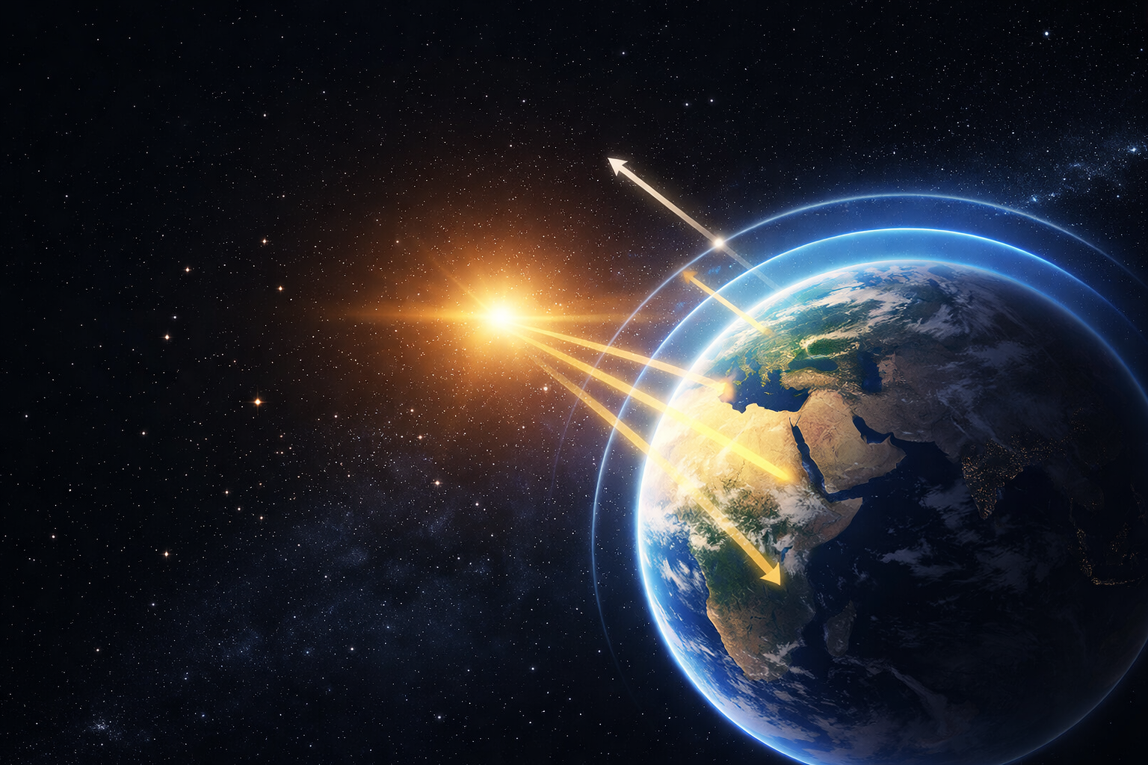
How sunlight intensity changes local air conditions
Learners use local measurements to test how sunlight can affect conditions near Earth’s surface
Light intensity
Brightness of the natural light at the sensor.
Usually highest in direct sun.
Air temperature
How warm or cool the air is.
It should rise when sunlight is stronger.
Relative humidity
How much water vapour the air holds compared with the maximum possible at that temperature.
It may vary more than the other two data sets.
Facilitator note: if humidity does not show a neat pattern, learners can still present a valid conclusion by describing that uncertainty honestly.
MaxIQ Space | Space STEM kit support materials
Notes:
[Sources]
Generated image asset: OpenAI image generation (atmosphere and sunlight illustration), created for this deck.
CAPS Natural Sciences Grades 7-9: visible light and spectrum content (uploaded file: CAPS SP NATURAL SCIENCES GR 7-9 WEB.pdf, pp. 51-53).
CAPS Natural Sciences Grades 7-9: atmosphere, ozone absorbing ultraviolet radiation, and greenhouse effect (uploaded file: CAPS SP NATURAL SCIENCES GR 7-9 WEB.pdf, pp. 81-82).
The explanation of what the kit readings represent is standard sensor interpretation aligned to the user-provided kit capabilities.
[/Sources]

Slide 6
Springbot Coding or STEM standard code
MaxIQ Space | Space STEM kit support materials
Notes:
[Sources]
Generated image asset: OpenAI image generation (atmosphere and sunlight illustration), created for this deck.
CAPS Natural Sciences Grades 7-9: visible light and spectrum content (uploaded file: CAPS SP NATURAL SCIENCES GR 7-9 WEB.pdf, pp. 51-53).
CAPS Natural Sciences Grades 7-9: atmosphere, ozone absorbing ultraviolet radiation, and greenhouse effect (uploaded file: CAPS SP NATURAL SCIENCES GR 7-9 WEB.pdf, pp. 81-82).
The explanation of what the kit readings represent is standard sensor interpretation aligned to the user-provided kit capabilities.
[/Sources]

Slide 7
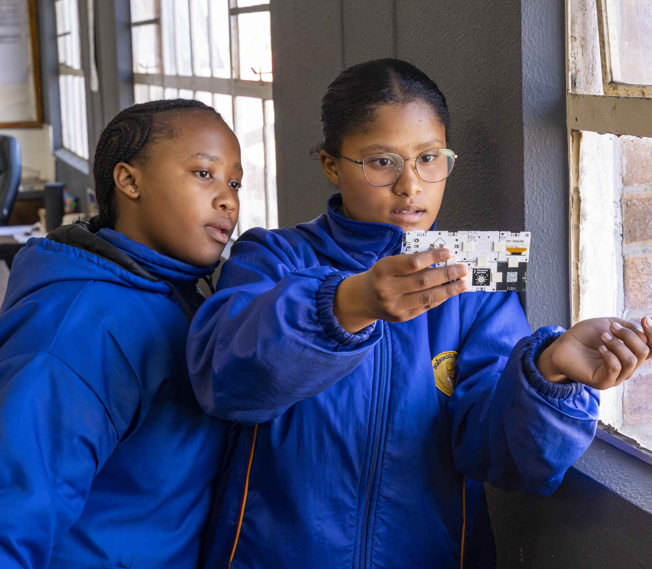
How to run the experiment
Designed for 9 pairs with 10 kits, reading the data from the OLED screen and/or saving the data to a micro-SD card.
1
Choose three locations: full sun, partial shade and deep shade / indoors near a window.
2
At each location, hold the sensor at the same height and in the same orientation.
3
Wait for the OLED readings to settle, then record light, air temperature and relative humidity.
4
Take three readings per location, one minute apart if time allows.
5
If a micro-SD card is fitted, save the readings as CSV for later checking and graphing.
6
Return to class, calculate averages and compare the three locations.
Fair test reminders: same sensor height, same number of readings, same recording units
MaxIQ Space | Space STEM kit support materials
Notes:
[Sources]
Generated image asset: OpenAI image generation (students using a sensor kit outdoors), created for this deck.
CAPS Natural Sciences Grades 7-9: process skills include planning investigations, measuring, recording information, interpreting information, and communicating (uploaded file: CAPS SP NATURAL SCIENCES GR 7-9 WEB.pdf, pp. 10-11).
CAPS Life Sciences Grades 10-12: investigating phenomena includes following instructions, handling equipment, recording information, measuring, interpreting, and planning investigations (uploaded file: CAPS FET _ LIFE SCIENCES _ GR 10-12 Web_2636.pdf, pp. 16-17).
[/Sources]

Slide 8
From readings to evidence
An example data pattern learners can compare with their own results
Example
What to ask learners
Location | Light (lux) | Temp (deg C) | RH (%)
A: Full sun | 18,500 | 31.2 | 41
B: Partial shade | 7,300 | 28.4 | 49
C: Deep shade | 1,200 | 26.8 | 55
Which location has the highest light intensity?
Does the warmest location also have the highest light reading?
How does humidity compare across the three locations?
What can sunlight explain, and what might be linked to other environmental factors?
Full
sun
Partial
shade
Deep
shade
MaxIQ Space | Space STEM kit support materials
Notes:
[Sources]
Example dataset is illustrative and created for teaching purposes by the assistant; it is not presented as measured field data.
CAPS Life Sciences Grades 10-12: learners should record information in tables, convert information into graphs, interpret data, recognise patterns and trends, and make deductions based on evidence (uploaded file: CAPS FET _ LIFE SCIENCES _ GR 10-12 Web_2636.pdf, pp. 16-17).
[/Sources]

Slide 9
How learners present results
Use a short claim-evidence-explanation-conclusion structure
Claim
Evidence
Explanation
Conclusion
What is your main finding?
Which numbers or graph support it?
Why might this pattern happen?
What do you conclude overall?
Assessment focus
Accuracy of results | Use of evidence | Quality of explanation | Clear teamwork and speaking
Facilitator prompt: “If your humidity data is inconsistent, say so and explain what might have influenced it.”
MaxIQ Space | Space STEM kit support materials
Notes:
[Sources]
The presentation structure and rubric wording are designed by the assistant for this lesson.
CAPS Natural Sciences Grades 7-9: communicating is a core process skill (uploaded file: CAPS SP NATURAL SCIENCES GR 7-9 WEB.pdf, pp. 10-11).
CAPS Life Sciences Grades 10-12: learners should communicate findings and interpret information from tables and graphs (uploaded file: CAPS FET _ LIFE SCIENCES _ GR 10-12 Web_2636.pdf, pp. 16-17, p. 23).
[/Sources]

Slide 10
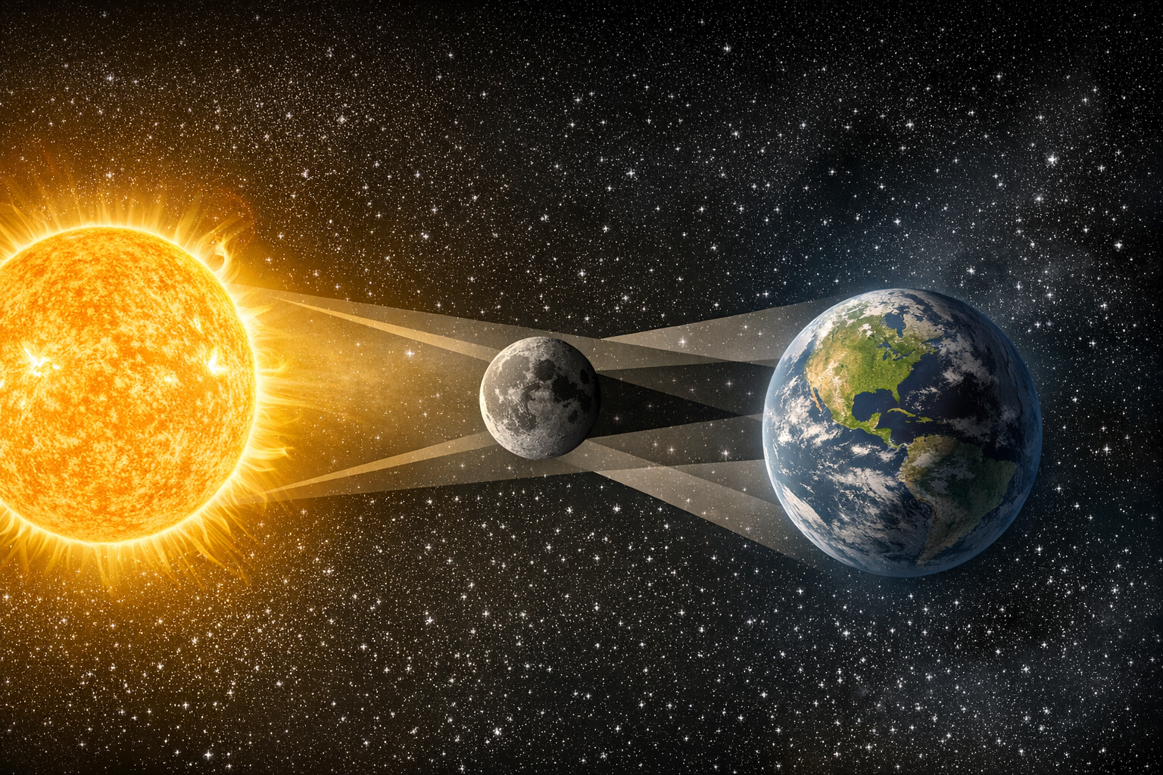
A solar eclipse: Sun, Moon, and Earth alignment
The Moon blocks sunlight by passing between the Sun and Earth.
MaxIQ Space | Space STEM kit support materials
Not to scale
Notes:
[Sources]
Generated image asset: OpenAI image generation (atmosphere and sunlight illustration), created for this deck.
CAPS Natural Sciences Grades 7-9: visible light and spectrum content (uploaded file: CAPS SP NATURAL SCIENCES GR 7-9 WEB.pdf, pp. 51-53).
CAPS Natural Sciences Grades 7-9: atmosphere, ozone absorbing ultraviolet radiation, and greenhouse effect (uploaded file: CAPS SP NATURAL SCIENCES GR 7-9 WEB.pdf, pp. 81-82).
The explanation of what the kit readings represent is standard sensor interpretation aligned to the user-provided kit capabilities.
[/Sources]

Slide 11
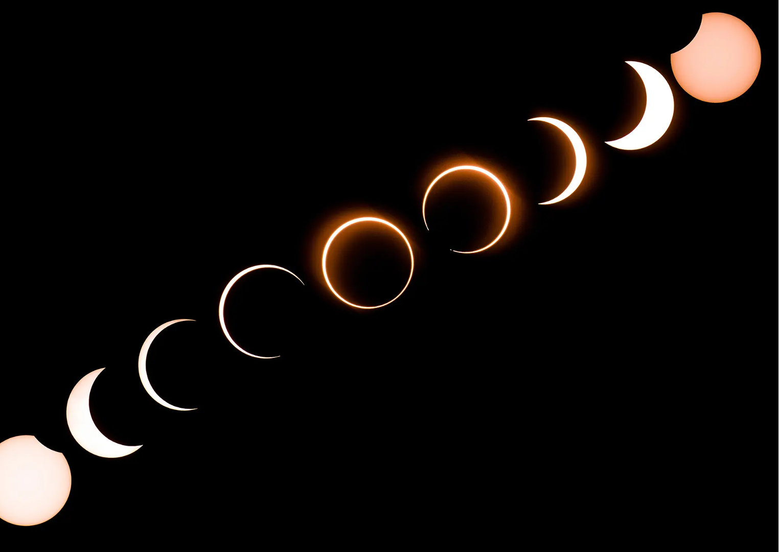
What is a solar eclipse?
Link global solar system events to changes in sunlight near Earth’s surface.
A solar eclipse happens when the Moon passes
between the Sun and Earth
This blocks some or all the Sun’s light from reaching
a specific area on Earth for a short time.
Sunlight intensity drops rapidly
As the Moon covers the Sun, light levels can fall
sharply, even during daytime.
Local conditions can respond to reduced sunlight
During an eclipse, air temperature may decrease
slightly and humidity patterns may change.
Why this matters for this investigation
An eclipse provides a real-world example of how
changes in sunlight intensity affect conditions near
Earth’s surface.

Slide 12
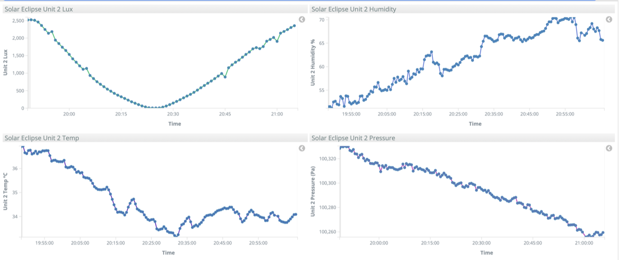
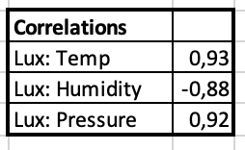
How do our results compare with the data collected during a solar eclipse?
Learners get to see the data collected during an intense period of change in sunlight intensity
Facilitator note: This is a screenshot of data collected during a solar eclipse in the USA in 2017. Lux is the technical term for light intensity.
The data set may be found in the folder for this topic.
MaxIQ Space | Space STEM kit support materials
Notes:
[Sources]
Generated image asset: OpenAI image generation (atmosphere and sunlight illustration), created for this deck.
CAPS Natural Sciences Grades 7-9: visible light and spectrum content (uploaded file: CAPS SP NATURAL SCIENCES GR 7-9 WEB.pdf, pp. 51-53).
CAPS Natural Sciences Grades 7-9: atmosphere, ozone absorbing ultraviolet radiation, and greenhouse effect (uploaded file: CAPS SP NATURAL SCIENCES GR 7-9 WEB.pdf, pp. 81-82).
The explanation of what the kit readings represent is standard sensor interpretation aligned to the user-provided kit capabilities.
[/Sources]

